Slide 1
High Point: Using Data as a Tool to Reduce Blight
May 25, 2017
N. C. Community Development Association
Annual Conference

Slide 2
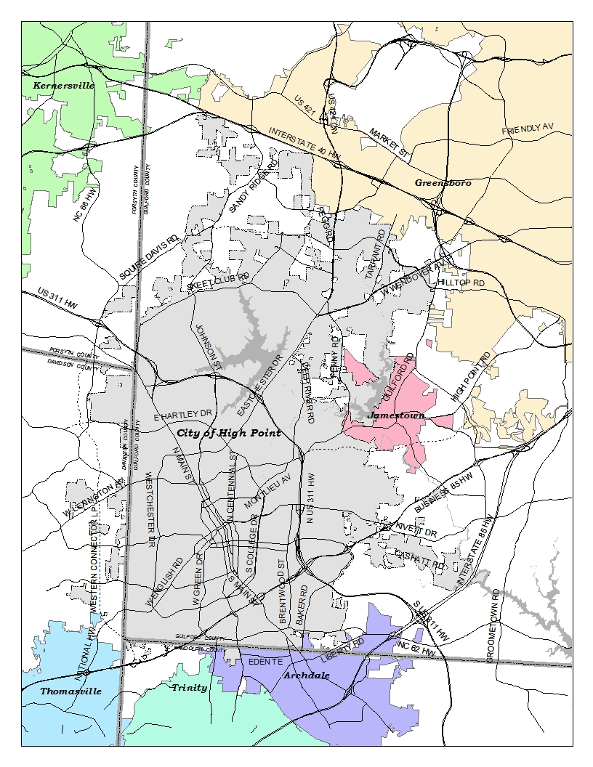
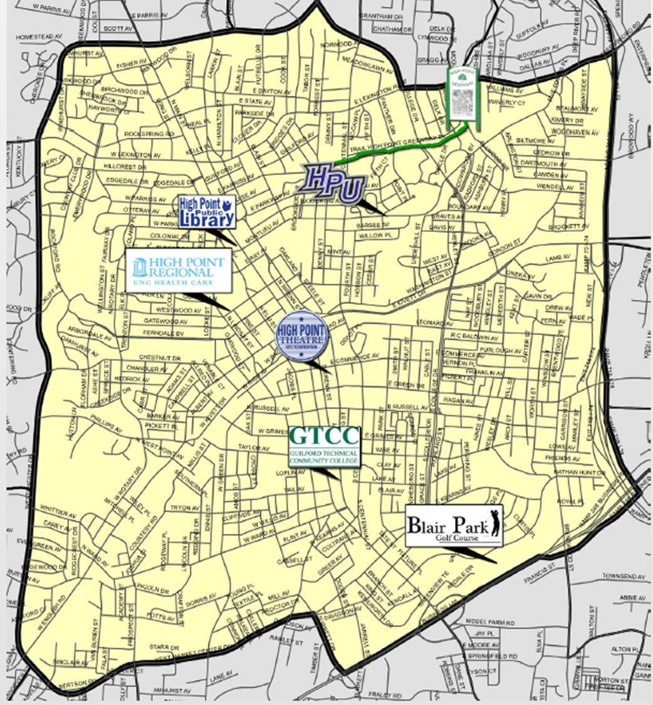
High Point - Maps
Notes:
City limits – more than 55 sq miles
Population of more than 112, 000, it is the ninth largest city in North Carolina

Slide 3
High Point – City of Contrasts (2013)
Entire City
Population: 105,723 (112,201 – 2017 est.)
Median HH Income: $45,400
Poverty Rate: 21.4%
Renter-occupied: 42.8%
Core City
Population: 30,879
Median HH Income: $29,800
Poverty Rate: 38.7%
Renter-occupied: 59%

Slide 4
Core City Challenges
Large racially concentrated areas of poverty leading to:
  Food deserts;
  Low homeownership rates; and
  Low employment rates.
Blighting influences
  Vacant lots (20%);
  Vacant homes (9.7%); and
  Fire damaged units (175).
Concerns of community safety
  Liquor houses
  Drug houses
  Prostitution
  Block parties

Slide 5
Planning Efforts since 1999
Macedonia Neighborhood Plan (1999)
Southside Neighborhood Plan (2004)
Core City Plan (2007)
However, had difficulties deciding how to strategically implement plans
Go where it looks the worst
Go where politicians direct
Could not reach critical mass

Slide 6
Prior Code Enforcement Efforts
(Pre-2015)
Complaint-driven
Little to no connection with community development efforts
Little to no communication/organizing with other city departments (Police, Fire, Community Development)
Reluctance to demolish dwellings that were substandard
  North Carolina is a property rights state
  Political environment
  Economy

Slide 7
Fiscal Year 2014/2015 Changes
New City Manager = fresh set of eyes (Jan 2015)
  Different perspective – how outsiders viewed the city
  Brought a focus of esthetics
Budget for 2015/16 approved to hire 4 new inspectors
New Assistant City Manager (July 2015)
Started using new software (August 2015)
  Accela – used by multiple departments
  Worked out of 2 systems

Slide 8
Fiscal Year 2014/2015 Changes
Local Codes Section moved to Community Development and Housing in February 2016
  Spring of 2016 down to 1 inspector for a short period
  Had a backlog of 270 cases in the “old” system
6. Center for Community Progress Leadership Institute – Fall 2015 (attended by City Manager and Council members)

Slide 9
High Point 2017 Strategic Plan
The three planning goals approved by City Council:
Increase the population of active, engaged, entrepreneurial and working millennials living in High Point by 25%
100% proactive enforcement of codes
Create a downtown catalyst project that produces:
  500 private sector jobs
  15 to 20 new restaurants and shops
  250 additional residential housing units
  A centralized gathering place
Notes:
Overarching goal: Increase property values

Slide 10
Where are we now?
Hired new code enforcement manager July 2016
Hired 6 new code enforcement officers from April 2016 to November 2016
Reduced backlog of 270 cases to 78 in April 2017
We work with Police and Fire Departments
  Educating police on when they can/should make referrals to us
  Fire reports fire calls to us
We refer homeowners that need repairs to the Affordable Housing Division
  Educated inspectors on this process and when to make referrals

Slide 11
April 2017
a. Minimum Housing Complaints | 40
b. Active Minimum Housing Cases | 252
c. Active Backlog Cases (270 original) | 78
d. Cases Taken Before City Council
i. For Demolition | 6
ii. For Vacate | 0
e. City Demolished Houses | 5
a. Public Nuisance Complaints (includes unsecured dwellings) | 84
b. Active Public Nuisance Cases | 294
c. City abated PN Cases | 6
d. Owner abated PN Cases | 61
a. Zoning Complaints ( Vehicles, Signs, Banners) | 15
b. Signs collected * | 112

Slide 12
Opportunities via External Sources
Established relationship with Center for Community Progress (CCP)
Engaged UNCG Center for Housing & Community Studies to complete Housing Segmentation Study in 2016
In 2016, City awarded Technical Assistance Scholarship Program (TASP) from CCP
  One of three cities (Baltimore and Rockford, IL)
  200 hours of technical assistance over a six-month period
  Learn/discuss innovative strategies to address vacant property, abandonment and tax delinquency
Notes:
CCP intro via Dan K Sept 2014
Application approved to attend 2015 Community Progress Leadership Institute (CPLI) @ Harvard (one of three state delegations made up of seven cities)
Delegation from High Point was key to approval
Six weeks after CPLI, attended 2015 Reclaiming Vacant Properties in Detroit
Strategic planning and implementation
Almost ½ of Council members attended
In November 2015, attended CCP’s Code Enforcement Academy in Dallas
CHCS Director, Dr. Stephen Seals, introduced to City via Bill McNeil at Reclaiming Properties event
Focused on the Core City
Considered a wide variety of socio-economic variables (more than 70, down to 17); not causes, but correlations
Based on Census Block Groups
Helps provide data to prioritize redevelopment
Provide insights into development opportunities
Identify the difference making variables

Slide 13
Housing Market
Segmentation Study
Parcel-level housing stock assessment of the Core-City
Provides data to help prioritize redevelopment and revitalization activities
Block groups are divided into five ratings based on data.
  Stable (Green) – high home values, low vacancy rates, high homeownership.
  Functioning (Light Green) – moderate home values, varied vacancy rates and moderate homeownership.
  Constrained (Yellow) – moderate home values, higher vacancy rates, low homeownership, more substandard properties higher poverty and unemployment.
  Weak (Orange) – low home values, higher vacancy rates, low homeownership, substandard homes, many vacant lots, poverty and unemployment is very high.
  Extremely Weak (Red) – lowest home values, highest vacancy rates, highest rental rates, substandard homes and many lots are vacant. Poverty and unemployment is the highest.

Slide 14
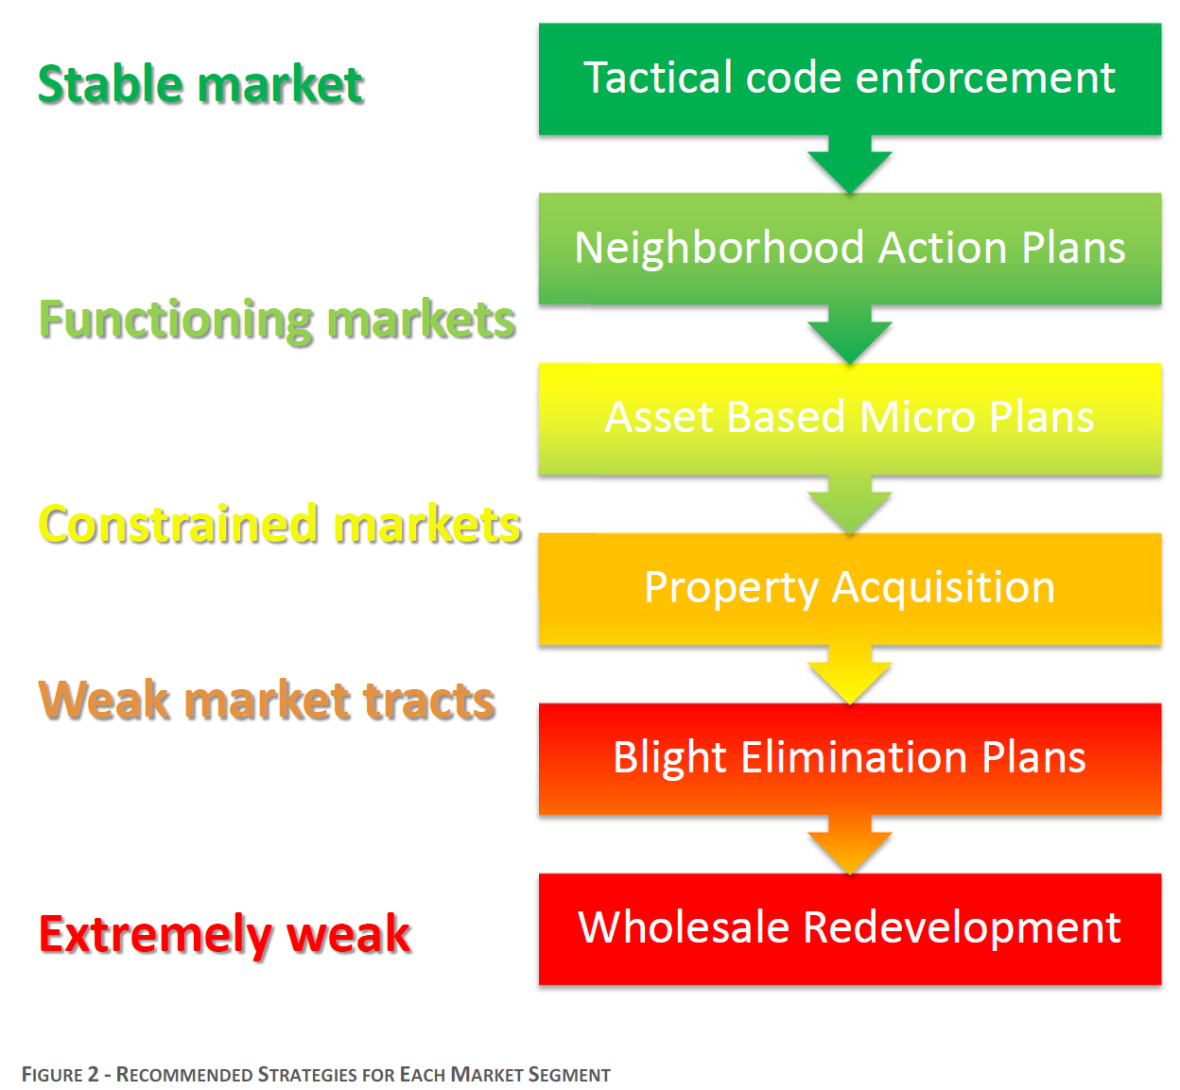
Strategies for Market Segments:
Indirect correlation between market index and improvement costs.
Strategies are informed and driven by data characteristics of each neighborhood.
Types of activity (resources) must be “right sized” to needs of the neighborhood.
Some areas will require working from the outside edges in.
Targeted code enforcement throughout Core to address blighting influences:
  Burnouts
  Dilapidated & abandoned properties
  High grass
All strategies will require effective community partnerships.

Slide 15
What We Learned from the Study
Very informative strategically, less so tactically
Parcel-level data is needed to be actionable
Data sources that can be updated are crucial
Tremendous amount of data generated by City & County
Other data sources can be very useful (e.g., RealtyTrac, MLS, Polk City Directory)
GIS is your friend!
https://www.highpointnc.gov/DocumentCenter/View/7024

Slide 16
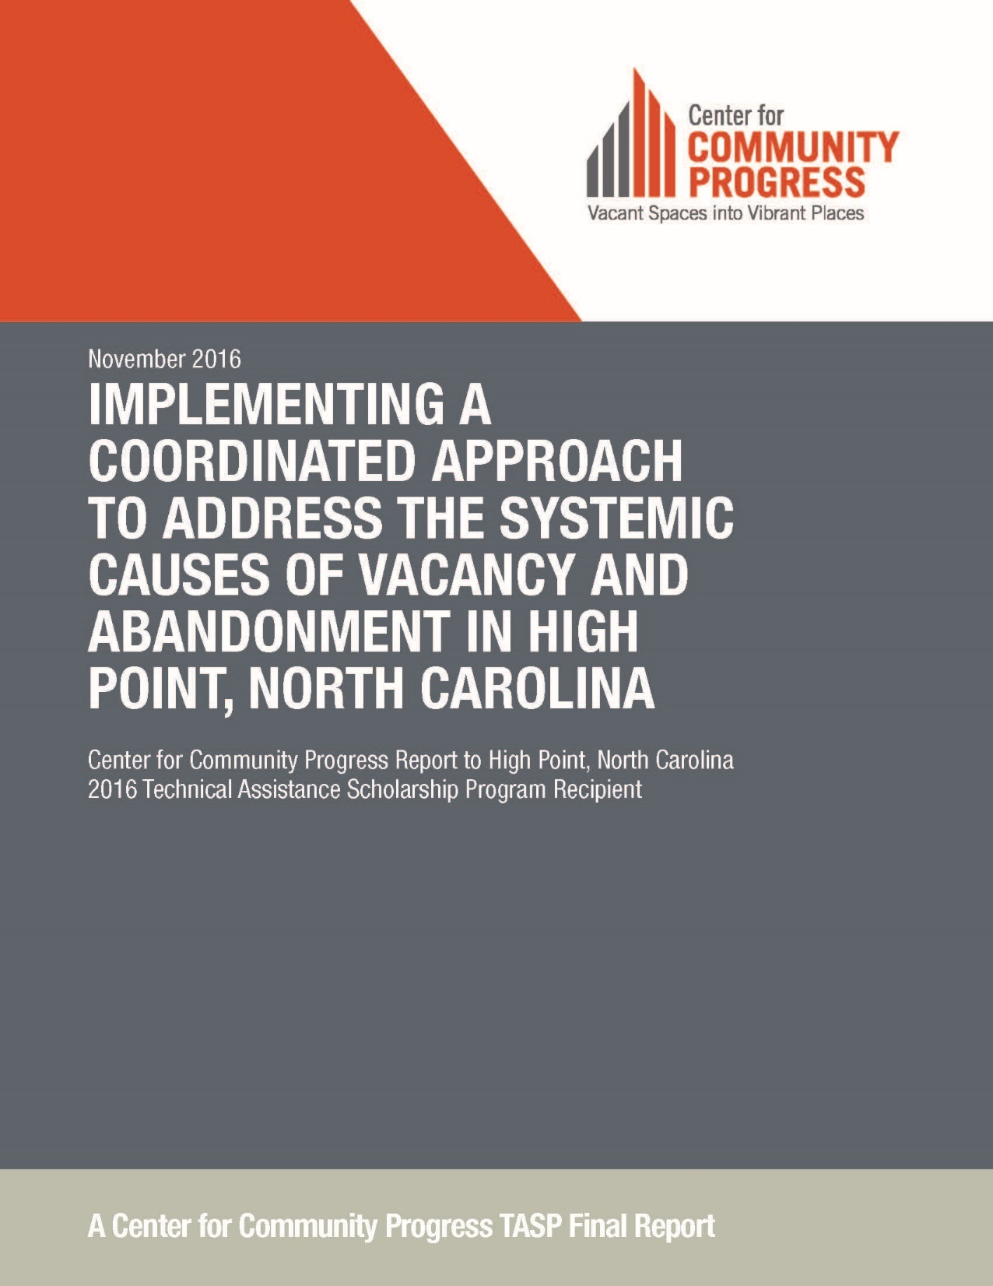
TASP 2016
Six month engagement
Four Focus Area:
  Data Management Systems & Practices
  Code Enforcement Systems
  Property Tax Enforcement Systems
  Community Partnerships and Programs
Stakeholders included:
  City Council
  CHP staff
  Guilford County Tax Office
  Guilford County Schools
  Community members
  Local Non-profits
https://www.highpointnc.gov/DocumentCenter/View/7023

Slide 17
Data Management Systems
Key Recommendations:
Create a Vacant and Abandoned Property Task Force
Create and empower the High Point Data Innovation Team
Data Innovation Team should prioritize implementation of new data platform
  Create public interface
Data Innovation Team should also focus on developing a plan, with involvement and support from UNCG Center for Housing and Community Studies, to update the parcel survey of all Core properties every three years, starting in 2018
City and County should formalize High Point’s ability to access the back-end of County’s GIS database, similar to arrangement that currently exists between Greensboro and County
Notes:
Response to #1: Core City Neighborhood Enhancement Team (Police, Fire, Planning CDH); first mtg w/in 60 days

Slide 18
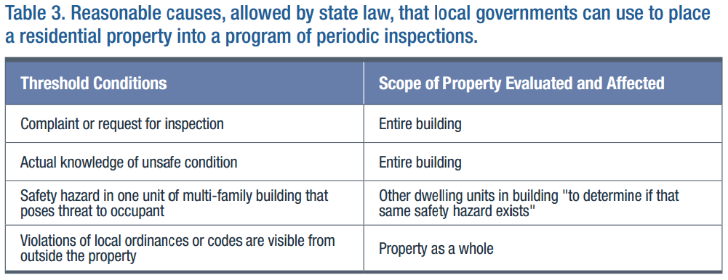
Code Enforcement Systems
Key Recommendations: Proactive Inspection Programs
Reasonable Cause Inspections
Targeted Area Inspections (must formally designate ‘blighted zones’)

Slide 19
Code Enforcement Systems
Key Recommendations: Proactive Inspection Programs
Reasonable Cause Inspections
Targeted Area Inspections
Problem Property Rental Registration or Permitting Program
  Frequent Code Violations
  High Crime
Vacant Property Registration
Recent amendments to state statute, effective 1/1/17, make this criteria virtually impossible to reach!
Regardless of which program(s) the City finds of value and ultimately pursues, City officials are encouraged to consider establishing a relocation assistance program for tenants as authorized by G.S. Chapter 133 Article 2 in order to mitigate unintended negative consequences.
Notes:
The city program, which started in 2012, requires the owners of rental properties that accumulate three code violations in 12 months to enter the program. Landlords in the program must pay a $1,000 fine and are given a year to clean up their properties to avoid further violations.
The law reduces the fine to $500 and increases the number of violations to four. It also increases the amount of time landlords have to fix problems from 10 days to 21 days and says that any corrected issue is no longer a violation, according to Shuford.
That part of the law renders the RAMP program unworkable, he said.
"A property owner could have a dozen violations but if they were each corrected in 21 days or less, they wouldn't count and the property would never enter RAMP," Shuford said. "As a result, the city has discontinued using RAMP as an enforcement tool."
Before the program started, more than 125 residential rental properties in the city had three or more code violations, Shuford said. From August 2015 to May, there was one property in the program. In the 2014-15 fiscal year, 87 property owners with two code violations corrected the problems so they avoided the program.
Source: 9/8/16 news article

Slide 20
Code Enforcement Systems
Key Findings and Recommendations: Audit and Modify Local Minimum Housing Ordinance
Repair Orders
Finding: Currently, if a residence is cited for violations under the minimum housing code, repair orders are issued that grant the owner the option to “repair” or “vacate and close.” It seems many owners are simply choosing the latter to achieve compliance, and effectively eliminating the City’s ability to pursue additional enforcement options.
Recommendation: Consider the advantage of altering local ordinance so that the residents cited under minimum housing code are ordered to “repair, alter, or improve” only, as authorized by G.S. 160A-443(3)(a).
Notes:
The city program, which started in 2012, requires the owners of rental properties that accumulate three code violations in 12 months to enter the program. Landlords in the program must pay a $1,000 fine and are given a year to clean up their properties to avoid further violations.
The law reduces the fine to $500 and increases the number of violations to four. It also increases the amount of time landlords have to fix problems from 10 days to 21 days and says that any corrected issue is no longer a violation, according to Shuford.
That part of the law renders the RAMP program unworkable, he said.
"A property owner could have a dozen violations but if they were each corrected in 21 days or less, they wouldn't count and the property would never enter RAMP," Shuford said. "As a result, the city has discontinued using RAMP as an enforcement tool."
Before the program started, more than 125 residential rental properties in the city had three or more code violations, Shuford said. From August 2015 to May, there was one property in the program. In the 2014-15 fiscal year, 87 property owners with two code violations corrected the problems so they avoided the program.
Source: 9/8/16 news article

Slide 21
Code Enforcement Systems
Key Findings and Recommendations: Audit and Modify Local Minimum Housing Ordinance
Demolition Orders:
Finding: The City’s local ordinance currently states that if the estimated costs to repair are more than 50% of the property’s current value, then the City shall order the property demolished. This may compel the City to order demolition more than is necessary.
Recommendation: Adjust the City’s “reasonable cost of repair” percentage as authorized under G.S. 160A-443(3). Given the market conditions of many Core neighborhoods, and the City’s stated goal to use demolition as a last resort, a higher percentage (65 – 75%) seems appropriate.
Notes:
The city program, which started in 2012, requires the owners of rental properties that accumulate three code violations in 12 months to enter the program. Landlords in the program must pay a $1,000 fine and are given a year to clean up their properties to avoid further violations.
The law reduces the fine to $500 and increases the number of violations to four. It also increases the amount of time landlords have to fix problems from 10 days to 21 days and says that any corrected issue is no longer a violation, according to Shuford.
That part of the law renders the RAMP program unworkable, he said.
"A property owner could have a dozen violations but if they were each corrected in 21 days or less, they wouldn't count and the property would never enter RAMP," Shuford said. "As a result, the city has discontinued using RAMP as an enforcement tool."
Before the program started, more than 125 residential rental properties in the city had three or more code violations, Shuford said. From August 2015 to May, there was one property in the program. In the 2014-15 fiscal year, 87 property owners with two code violations corrected the problems so they avoided the program.
Source: 9/8/16 news article

Slide 22
Strategic Use of Data
Goal from City Council to achieve 1:1 ratio of complaint driven cases vs. city initiated cases
  Identify substandard properties
  Approach strategically using all data available
    Delinquent taxes, amount of taxes owed, calls for police service, no utility services, previous code enforcement cases and several other search criteria
    = Tolemi (Opportunity Space)

Slide 23
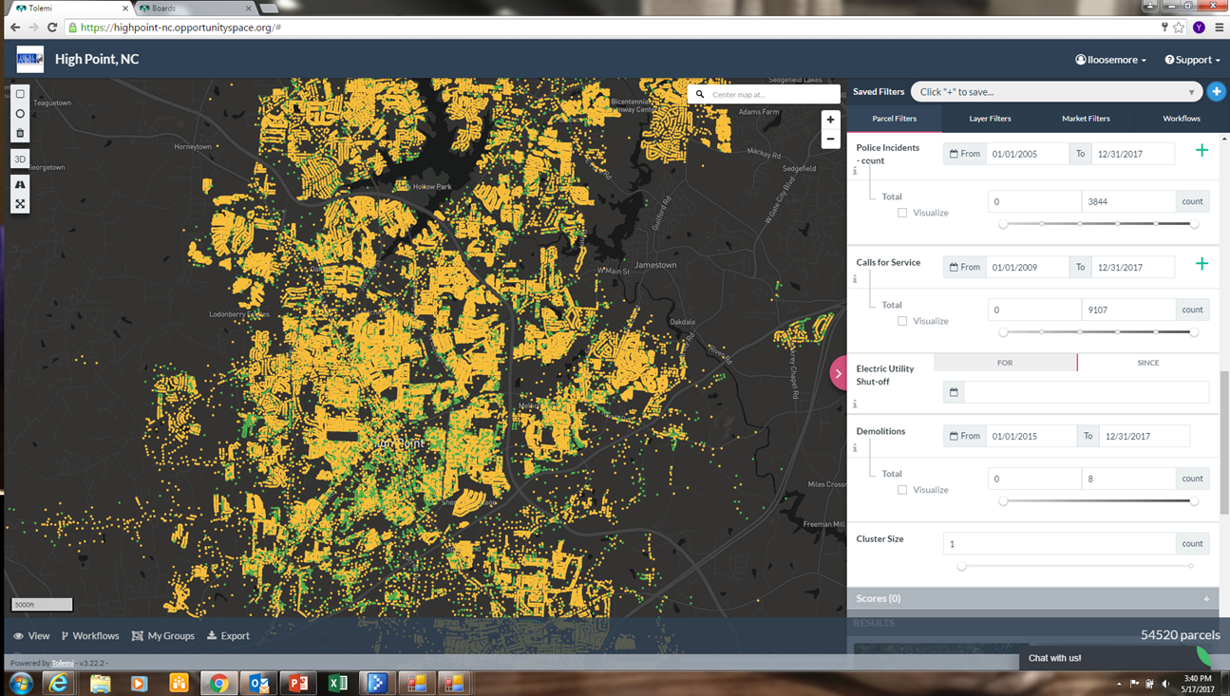
Tolemi (Formerly Opportunity Space)
Notes:
This is a map of the entire city – note bottom right corner shows 54,520 parcels (green and yellow dots differeniate between vacant lots and buildings)

Slide 24
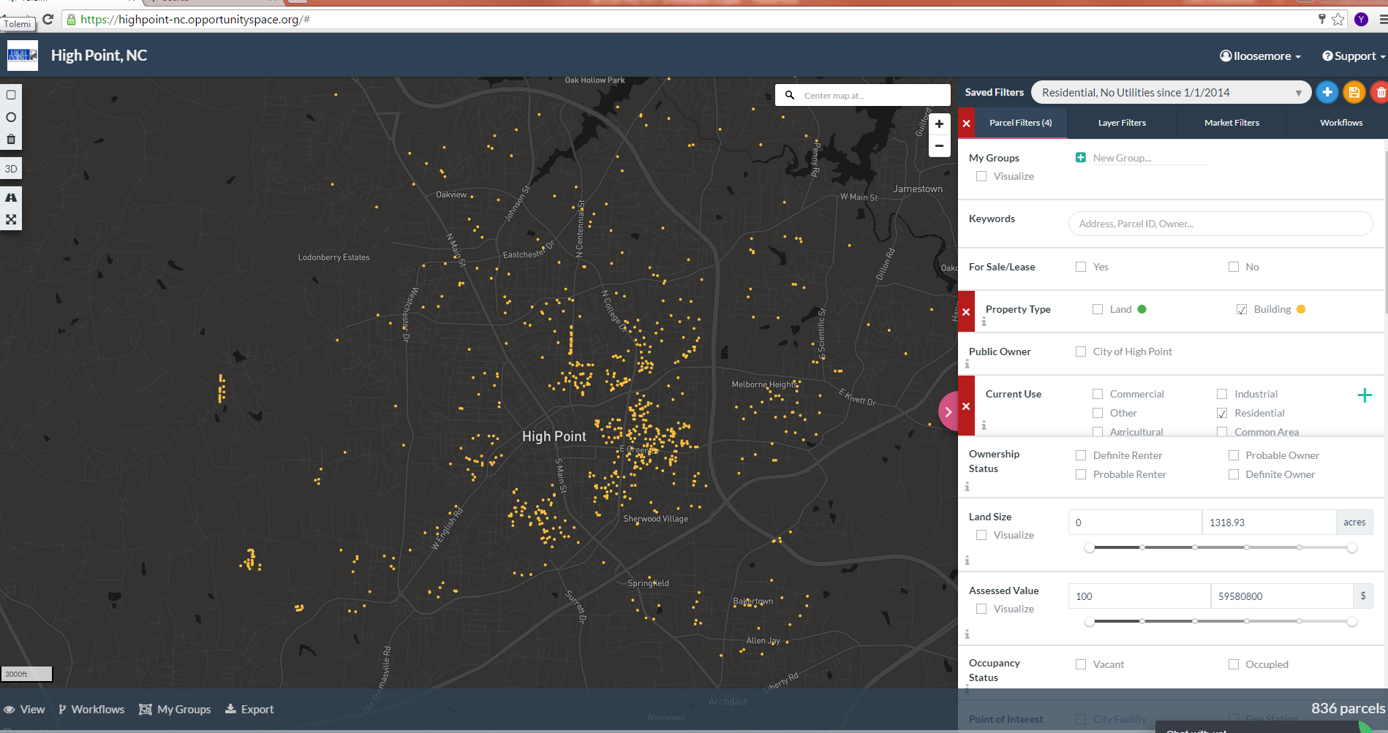
Notes:
This is a search for residential buildings, that have not had utilities since 1/1/2014 – bottom right hand corner changed to 836 parcels (from 54,520 we started with)
So if you keep on this process you can add different criteria such as calls for service, delinquent taxes, etc.
We want to do a matrix to prioritize issues and this will identify the properties by data of which ones probably need code enforcement.

Slide 25
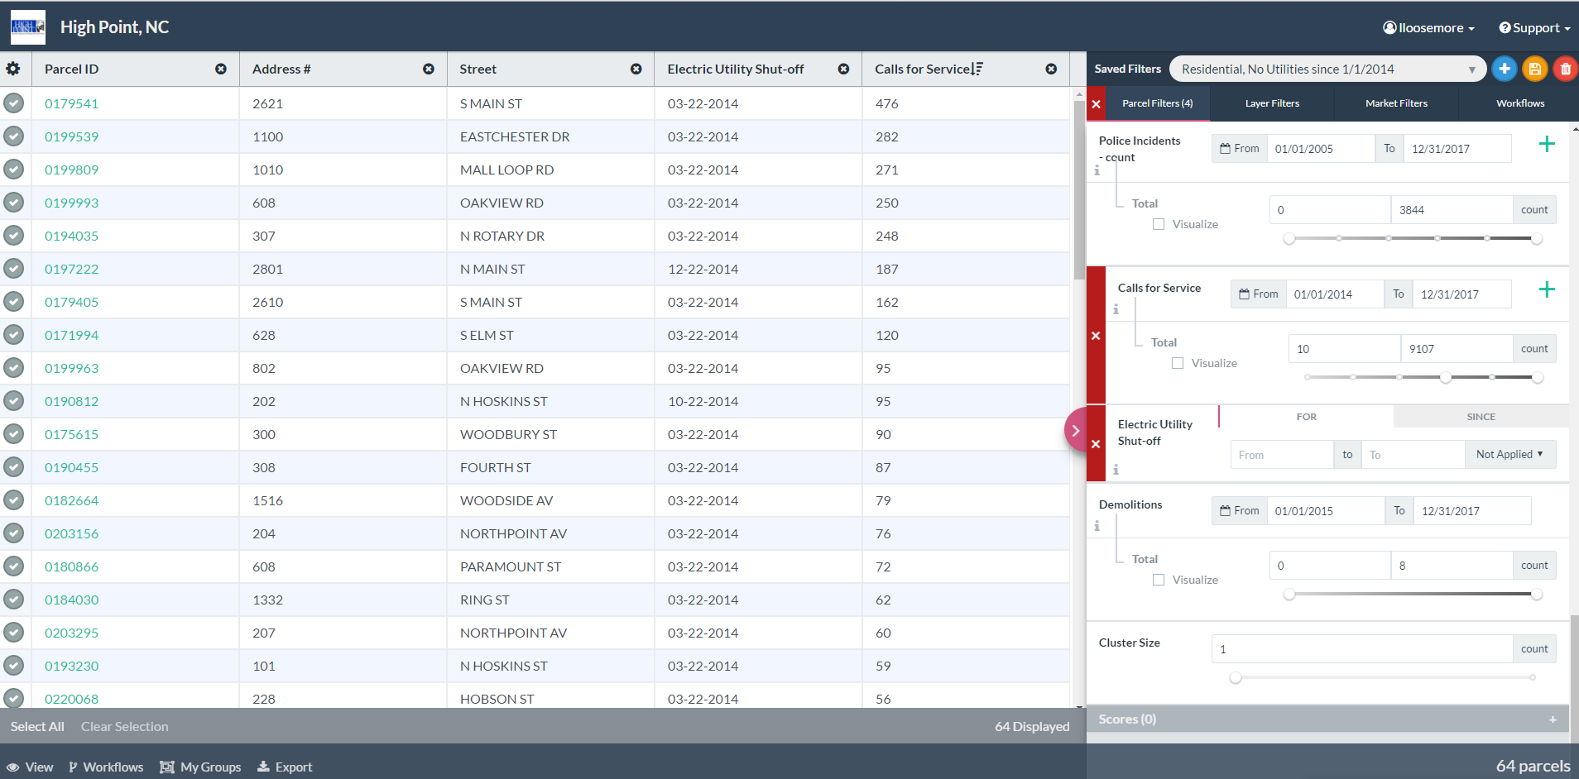
Notes:
Now I added additional criteria of calls for service from 1/1/2015 to 12/31/17 and sorted in a list view – Notice number of parcels lowered to 64.

Slide 26
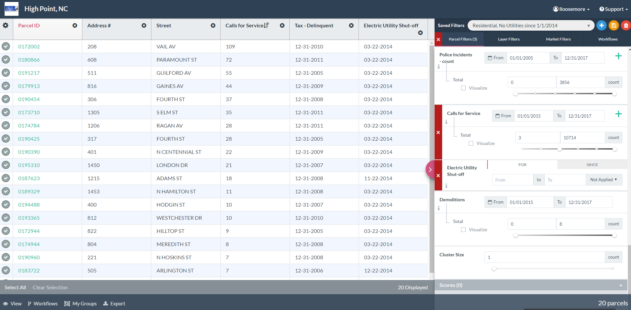
Notes:
Then I added a search for properties more than 5 years tax delinquent and calls for service from Police from 1/1/15 to 12/31/17 – took search down to 20 parcels. Our next step is to build a matrix to rank the properties and address in a strategic data driven manner. I believe this is going in the right direction because we already have active minimum housing cases on the majority of these properties and have demolished at least one.

Slide 27
Department Strategies to Strengthen Core
Pursuant to Council’s strategic plan for 2017 and the studies:
Mitigate blighting influences
  Demolish abandoned substandard structures
  Promote conversion of empty lots to community gardens (food deserts)
  Neighborhood cleanups – Keep High Point Beautiful
  Home repairs – OIAM, URP
  Repairs/New Construction – Small Builders Incentive Program
Diversify incomes
  Core-city homebuyer incentives
  Support of single- and multi-family construction
Maintain community partnerships
  Help reduce crime
Market our successes!

Slide 28

Operation InAsMuch
Matthew 25:40 where Jesus said “Inasmuch as ye have done it unto one of the least of these my brethren, ye have done it unto me.”
OAIM features a hands-on volunteer driven Blitz Day that focuses on improving the quality of life in low income neighborhoods.
Provides a platform for churches, non-profits, local government and individual citizens to develop a community oriented partnership that was fueled by the desire to help others.
Provides services such as repairs and yard clean ups for income eligible homeowners in targeted communities.

Slide 29
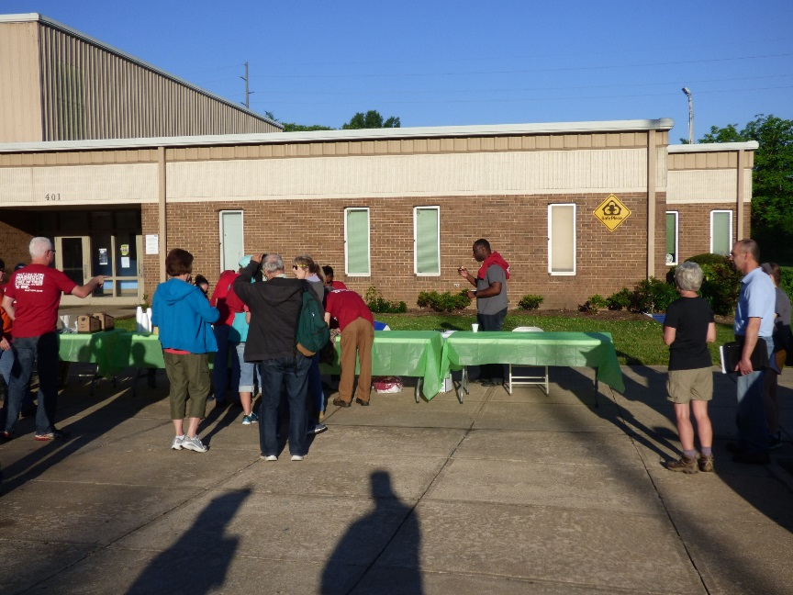
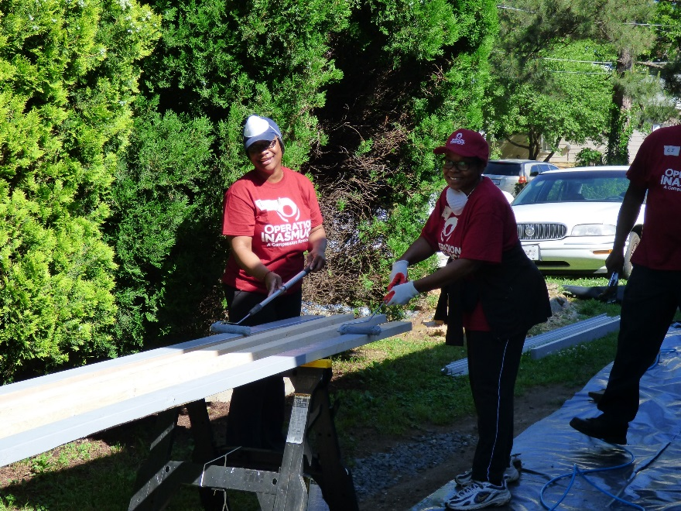
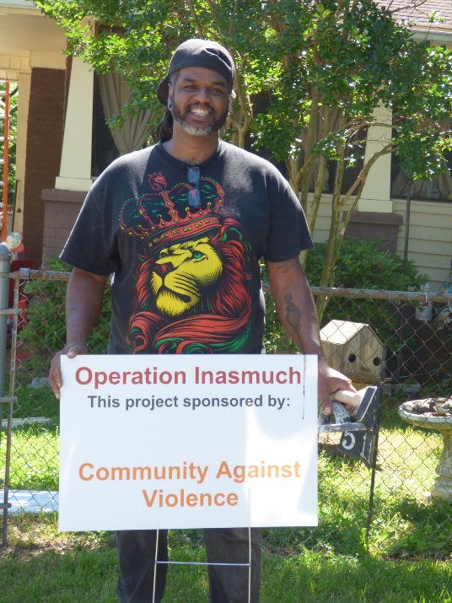
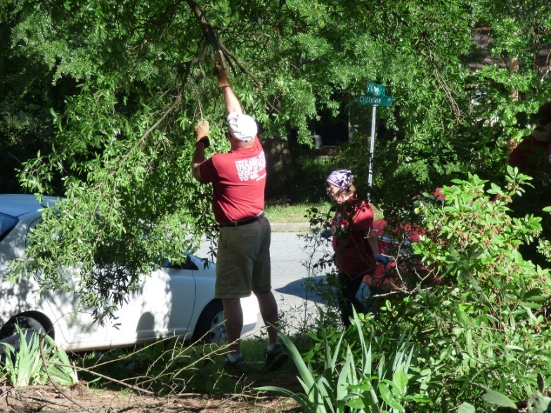
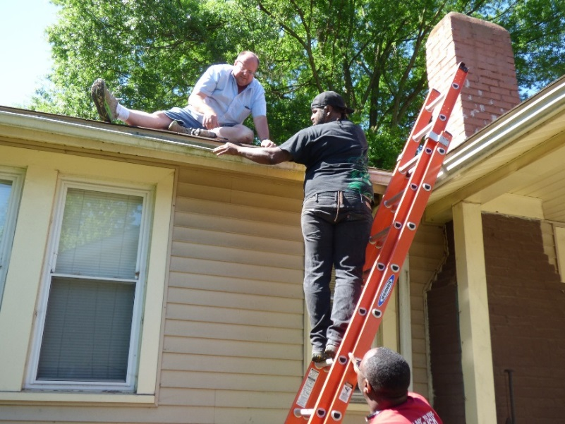
OPERATION INASMUCH
(Southside Community)
Video at https://www.highpointnc.gov/1838/Operation-Inasmuch

Slide 30
Moving Forward
Core City Homebuyer Incentive Program (income diversification)
Public/private partnerships – BNC ($5 million)
Core City CDC established
Awarded additional 75 hours of TA from CCP to assist with implementation of recommendations
Additional $500,000 proposed in Council’s FY2018 budget for Core City Redevelopment

Slide 31
Keys to Progress So Far
Leadership by Council and City Management
Data Collection, Management and Integration
Change in Organizational Culture (e.g., communications)
Questions/Conversations Across Departments
Notes:
Analysis of Impediments to Fair Housing Choice – deconcentrate RCAP and encourage middle-income households to buy in the CC

Slide 32
Contact Information
Richard Fuqua
(336) 883-3348
richard.fuqua@highpointnc.gov
Lori Loosemore
(336) 883-3040
lori.loosemore@highpointnc.gov

