Slide 1
What homebuyer programs does NCHFA offer to support your community-based homeownership efforts

Slide 2
Civil Rights Act & Fair Housing
Civil Rights Act of 1968 and the Fair Housing Amendments Act of 1988 apply to all housing in the US
The Federal Fair Housing Act & NC Fair Housing Act prohibit discrimination on the basis of: (protected class)
Race
Color
Religion
Sex
National Origin
Disability
Familial Status (Having children or being pregnant)
The NC Fair Housing Act also includes low income housing as a protected class.

Slide 3
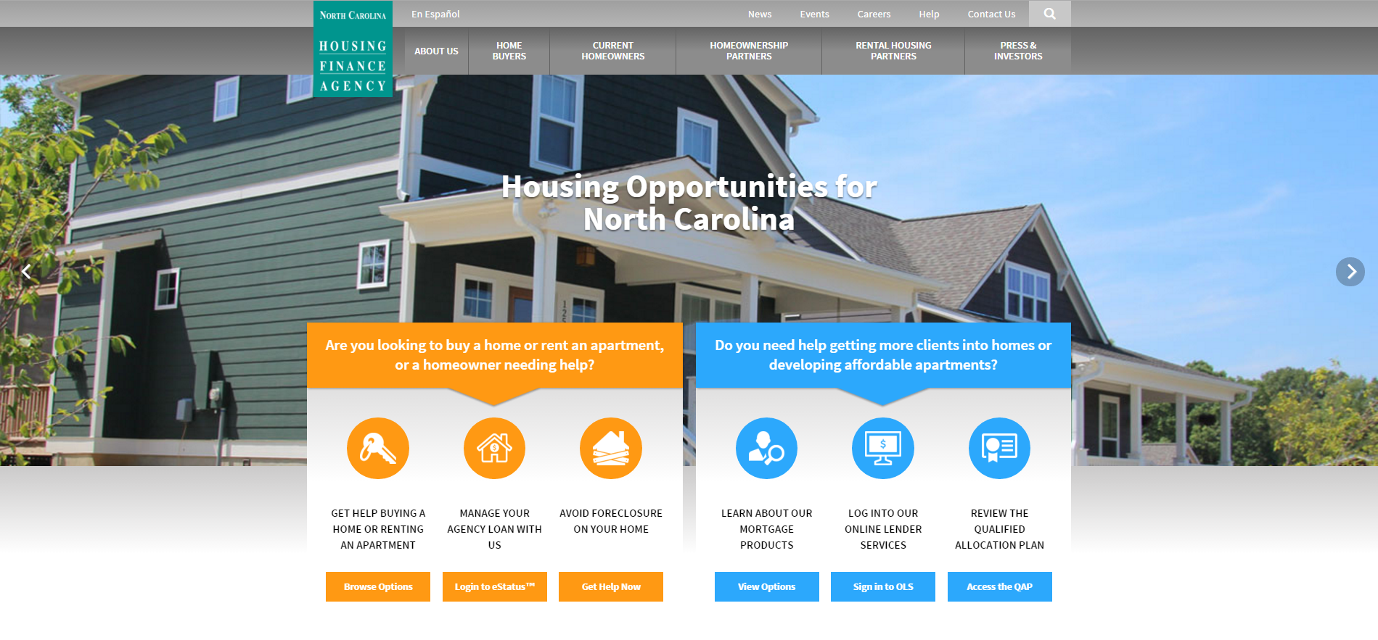
Our Mission
To create affordable housing opportunities for North Carolinians whose needs are not met by the market.

Slide 4
Agenda
Products for lenders (and realtors to be aware of)
NC Home Advantage Mortgage
3% & 5% Statewide Downpayment Assistance
First Time Home Buyer Mortgage Credit Certificates
Products for nonprofits & local governments
Community Partners Loan Pool
Self-Help Loan Pool
Educational Products for Home Buyers
E-Home America Express
Outreach & Partnership with Lenders & Realtors

Slide 5
NC Home Advantage First Mortgage Program

Slide 6
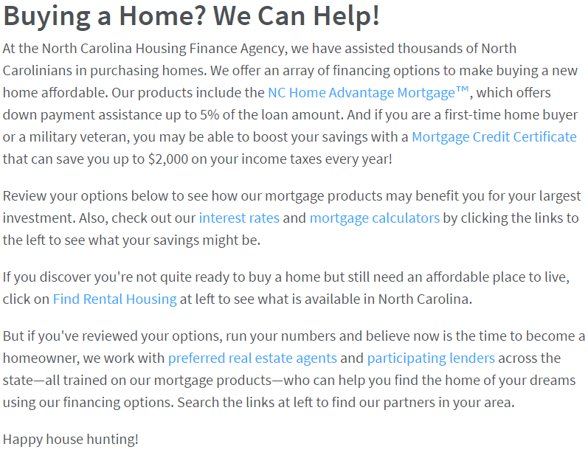
NC Home Advantage Mortgage
Amortizing 30 year First Fixed Rate Financing w/ market rates
All eligible borrowers are eligible for a 3% (Conv, FHA, VA, or USDA) or 5% (FHA or VA) forgiving DPA (years 11 to 15)
No Sales Price Limits
Streamlined Underwriting (4 forms, required for loan application)
Annual Income (applicant income) cannot exceed $87,500

Slide 7
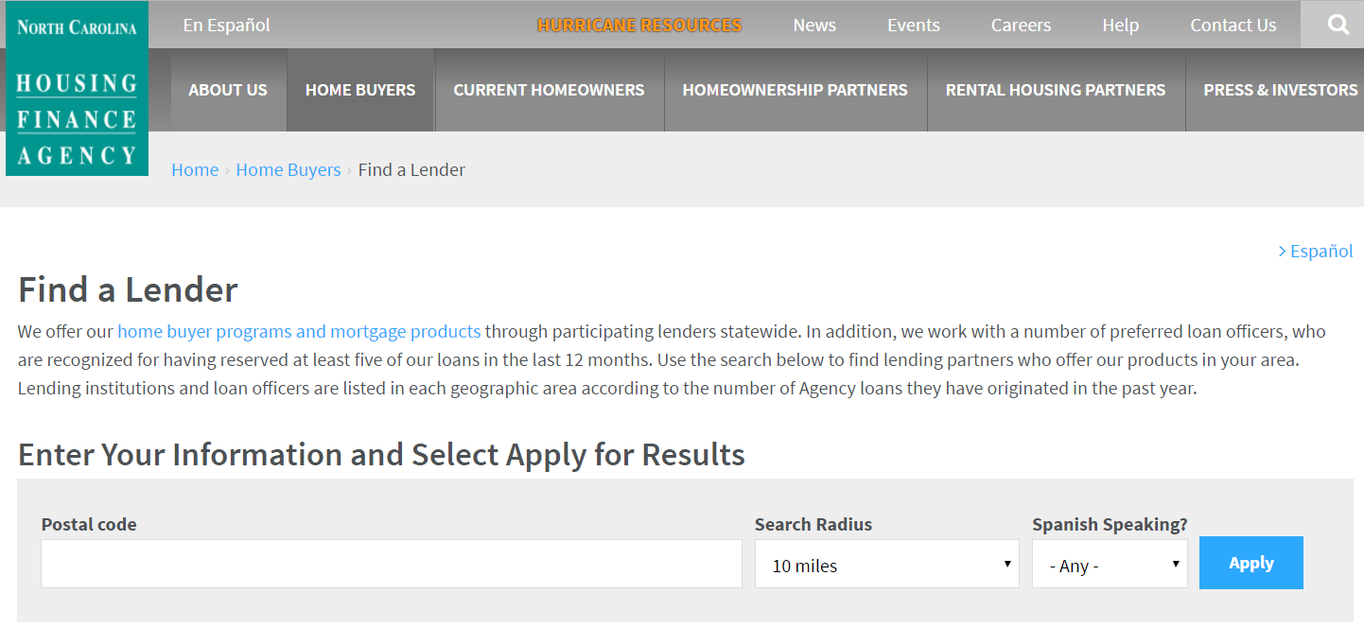
NC Home Advantage Mortgage
Middle credit score of 640 or higher
Automated Underwriting System (AUS) approval required
New 41% Debt-To-Income ratio (back end) effective 3/20/17; no front end
No borrower contribution requirement
New/Existing Single Family Homes, Townhomes, Condos, Duplexes (not Conv), & New Manufactured (not Conv)

Slide 8
Conventional Mortgage Insurance Coverage
Loan to Value | NC Home Advantage | Street Conventional Loan
95.01-97.00% | 18% | NA
90.01-95.00% | 16% | 30%
85.01-90.00% | 12% | 25%
80.00-85.00% | 6% | 12%
With a 20% CPLP Second if LTV is less than 80%
MI can be split or pre-paid.
When the conventional first mortgage is originated at or < 80% LTV = no MI. It may be possible to combine other downpayment resources to avoid MI.
8

Slide 9
Mortgage Credit Certificates For First-Time Buyers

Slide 10
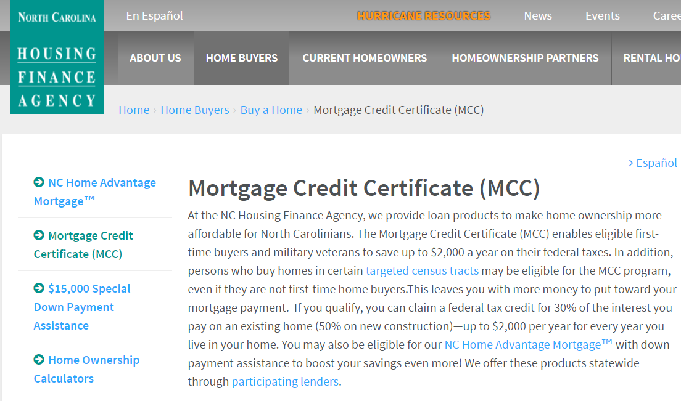
What is a Mortgage Credit Certificate (MCC)?
Federal Tax Credit on a borrower’s federal income tax return for 1st time homebuyers (or requalifying as 1st time homebuyers)
Provides a tax credit = to 30% (existing homes) or 50% (new homes) of total interest paid annually not to exceed $2,000/yr
Available for life of the loan as long as property is owner occupied
Can be re-issued 1 time w/n 12 months of refinancing when refinanced from a fixed rate loan to another fixed rate loan

Slide 11
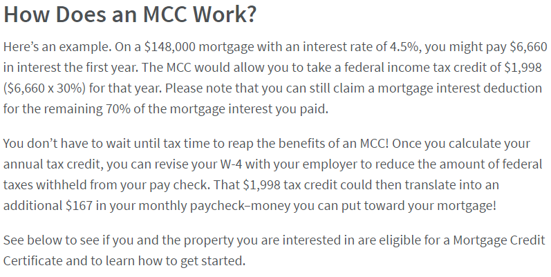
What is a Mortgage Credit Certificate (MCC)?
Only available through lenders working with the Agency: http://www.nchfa.com/home-buyers/buy-home/mortgage-credit-certificate
Income & Sales Price Limits: http://www.nchfa.com/home-buyers/income-limits

Slide 12
Community Partners Loan Pool (CPLP)
Additional Down Payment Assistance
to combine with NC Home Advantage Mortgage™

Slide 13
Community Partners Loan Pool (CPLP)
Down Payment Assistance up to 20%* of the Sales Price
O%, deferred, no payment 2nd mortgage;
Term matches 1st mortgage
Must be paired with N.C. Home Advantage Mortgage™ or USDA Section 502 Loan
For loans approved by 8/15/17 – Up to 25% of sales price

Slide 14
Temporary Funding Increase for CPLP
As of APRIL 3rd, 2017, the maximum amount of CPLP Assistance is temporarily increased to up to 25% of Sales Price.
For New & Existing Reservations that are UNDERWRITTEN & APPROVED by AUGUST 15, 2017.
NOTE: Increase may be extended beyond the date stated above subject to funding availability. If so, information will be posted on the NCHFA website.

Slide 15
Community Partners Loan Pool (CPLP)
NCHFA uses federal HOME funds to provide DPA for N.C. Home Advantage Mortgage™ borrowers who need more than 3% - 5%:
Limited to Low- to Moderate-Income buyers
Required Homeownership Education for all buyers
Maximum Sale Price Limits
Purchase New Homes or Homes < 10 Yrs. Old
Must apply for assistance thru CPLP Member

Slide 16
Who are our CPLP Members?
Non-profit Developers of affordable, for-sale homes
Non-profit Agencies that provide Home Buyer Education & Counseling
Public agencies which administer a homeownership program
Find a list of members by County Served: http://www.nchfa.com/homeownership-partners/community-partners/current-community-partners
Located throughout NC & NCHFA is actively recruiting new Members to expand CPLP network.
Fee paid to Loan Pool Members for loan packaging, education, & counseling

Slide 17
CPLP Member Roles:
Verifies Borrower Eligibility for CPLP:
Maximum Household Income 80% of Area Median Income
*HOME Program limits for NC by county & household size
Minimum Credit Score of 640 for Borrower/Co-Borrower
Housing Ratio: 20% Min. - 32% Max. Debt-to-Income Ratio: 41% Max
Verifies home meets Program Guidelines:
Sales Price < HOME Program Limits for N.C.
Passes required Home inspections
For new construction: Certificate of Occupancy
For existing homes: (1) N.C. Home Inspection &
(2) Minimum Housing Code Inspection
NOTE: If no local Code, a Housing Quality Standards (HQS) Inspection may be substituted.

Slide 18
CPLP Member Roles:
Provides required Home Buyer Education or partners with a Home Buyer Education Provider
Minimum total of 8.0 hrs. of Home Buyer Education & Counseling
NOTE: Education Certificate for all borrowers is submitted to NCHFA
Submits required borrower and house information via NCHFA Loan Pool Portal:
(1) Reservation Request
(2) Underwriting Package
Schedules closing date for CPLP Loan and coordinates with Borrower, Lender & Closing Attorney

Slide 19
Different Referral Scenarios:
MORE TIME
LESS TIME
1st Mortgage Lender refers N.C. Home Advantage Mortgage™ eligible borrower to CPLP Member for DPA
CPLP Member refers CPLP eligible borrower to Participating N.C. Home Advantage Mortgage™ Lender for 1st Mortgage
Loan officers who put together layered financing are a gift to their community. What a fantastic way to make a difference in the lives of your borrowers!

Slide 20
Down Payment Assistance
NC Home Advantage Mortgage™
Community Partners Loan Pool
Provides DPA up to 5% of loan amount
O% deferred payment 2nd mortgage forgivable in 15 yrs.
Provides DPA up to 20%* of Sales Price
O%, deferred payment 2nd mortgage; term matches 1st mortgage

Slide 21
Borrower Eligibility
NC Home Advantage Mortgage™
Community Partners Loan Pool
Up to $87,500 statewide limit
Looks at Applicant Income only (Qualifying Income)
Minimum 640 credit score
Max. Ratio: 41% DTI
Up to 80% of Area Median Income (HOME Program)
Looks at TOTAL Household Income
Minimum 640 credit score
Max. Ratios: 32% Hsg. & 41 DTI

Slide 22
Eligible Homes
NC Home Advantage Mortgage™
Community Partners Loan Pool
Single family, townhomes, condos, duplexes & new manufactured
Property age: No restrictions
Maximum Sales Price Depending on Loan Type
Both: Follow Insurer Guidelines
Follow Insurer Guidelines
Recommended Property age: New Homes and Existing Homes < 10 yrs.
Avoid Pre-1978 Homes
Maximum Sales Price Limits (HOME Program)

Slide 23
Home Buyer Education
NC Home Advantage Mortgage™
Community Partners Loan Pool
Only first time home buyers need to provide a Certificate of Completion
No Minimum hours of Education completed
ALL borrowers need to provide a Certificate of Completion
Minimum 8.0 hrs. of Education completed *NOTE: Check with Member on when education classes are scheduled.

Slide 24
Timeline for NCHFA Underwriting Approval
NC Home Advantage Mortgage™
Community Partners Loan Pool
Reservation Request & Rate Lock good for 60 days
NCHFA Approval within 1-2 business days
Reservation Request good for up to 90 days
Underwriting Package must be submitted within 15 business days of planned closing
NCHFA Approval within 2-3 business days

Slide 25
Timeline for Closing
NC Home Advantage Mortgage™
Community Partners Loan Pool
Lender sets closing date
TRID = 3 Days Final CD
CPLP Member selects closing date & coordinates with Closing Attorney
NCHFA requires Minimum 6 NCHFA business days
NCFHA always sends CPLP Closing Docs & Sends Check with Loan Funds to Closing*
NOTE: NC Home Ad Loan should be approved by NCHFA before scheduling closing

Slide 26
Timeline for Lender:
Lender provides N.C. Home Advantage Mortgage™ Reservation Confirmation to CPLP Member
CPLP Member: (1) Reserves CPLP funds and (2) Submits CPLP Underwriting Package
** NOTE: Lender can expect to close loan within 30 days of CPLP Underwriting Package submission
Once NCHFA approves CPLP loan, CPLP Member schedules Closing & Informs Closing Attorney
NOTE: NC Home Ad Loan should be approved by NCHFA before scheduling closing

Slide 27
Closing Process for CPLP Loan:
NCHFA’s Paralegal will send CPLP Pre-Closing Instructions & Documents to the Closing Attorney including Authorization to Close the CPLP loan
Closing Attorney needs to send requested closing documents to NCHFA Paralegal for final review and approval at least three (3) business days before closing

Slide 28
Closing Process for CPLP Loan:
Closing Docs from Closing Attorney that NCHFA reviews prior to closing include:
Copy of Title Commitment for 1st Lienholder
Copy of Final Closing Disclosure issued by 1st Mortgage Lender
Proposed HUD-1/HUD-1A Settlement Statement for the NCHFA CPLP Loan
Pre-Closing Instructions executed by closing attorney

Slide 29
Save Your Borrowers Some Time
When your borrower’s are shopping for a home insurance policy, remind them to include NCHFA’s interest with CPLP:
Proof of Homeowners Insurance with acknowledgement of NCHFA's loan interest(s)
Mortgagee Clause N.C. Housing Finance Agency ISAOA/ATIMA P.O. Box 28066 Raleigh, NC 27611-8066 CPLP Loan Number
For questions about closing a CPLP loan:
Liz Hair, NCHFA Paralegal
919-877-5712 or echair@nchfa.com

Slide 30
Frequently Asked Questions
Is there an approved lender list for the Community Partners Loan Pool?
Lenders must be approved to offer the NC Home Advantage Mortgage, but there is no approved lender list specific to CPLP. If you are a participating Lender for the Home Advantage loan, you are eligible to work with the CPLP. However, Borrowers can only request the CPLP loan through an approved CPLP Member organization.
Can Community Partners Loan Pool funds be combined with other Downpayment Assistance Programs and/or the Mortgage Credit Certificate?
Yes. But they cannot be combined with the special $15k DPA.

Slide 31
Frequently Asked Questions
Which NC Home Advantage Rate is used with the Community Partners Loan Pool?
Unless the borrower is ALSO applying for the 3% or 5% DPA assistance, the lowest (non-DPA) rate is used with CPLP.
When can the closing be scheduled when CPLP is used?
NCHFA needs 6 NCHFA business days notice to send funds to closing and review the loan documents. The CPLP Member schedules the closing using an online system. While NCHFA will issue CPLP underwriting approval PRIOR to NC Home Advantage underwriting approval, the closing should NOT be scheduled before the NC Home Advantage first mortgage has been approved by NCHFA.

Slide 32
Frequently Asked Questions
Who sends the disclosures, funding, and loan documents for the Community Partners Loan Pool?
NCHFA sends out disclosures, loan documents & funds to closing for the CPLP.
Are there income or sales price limits for the Community Partners Loan Pool?
YES: HUD HOME household income limits and sales price limits.
http://www.nchfa.com/sites/default/files/page_attachments/IncomeSalesPriceLimits.pdf These limits are NOT the same as the MCC or Home Advantage income limits. NC HOME AD > MCC/$15K > CPLP

Slide 33
Frequently Asked Questions
What happens at the end of CPLP Loan Term?
NCHFA would work out new terms on the loan with the borrower.
What happens if property values drop after purchase at future resale?
NCHFA will accept NET Proceeds at resale if resold for current market value. This is a borrower protection, but the borrower would have to claim amount written off as income.
What if the inspections show deficiencies?
HOME requires that all critical building systems have > 5 yrs of usable life & no health or safety threats remain at closing. Repairs/replacements would be need if < 5 yrs usable life or present a health/safety threat.

Slide 34
Homebuyer Counseling & Homebuyer Express
Online Pre-Purchase Education

Slide 35
National Industry Standards for Homeownership Education
Homebuyer Education (not the same thing as counseling, but related)
What MUST be covered as part of EVERY homebuyer education process:
Assessing Readiness to Buy a Home
Budgeting
Credit
Financing a Home
Home Purchase Process
Home Selection
Home Maintenance and Home Improvements
Financial Planning and Sustaining Home Ownership
Avoiding Delinquency and Foreclosure
Financial Peace University only marginally touches on some of these topics.
National Industry Standards for Homeownership Education and Counseling
http://www.homeownershipstandards.com/Home/Home.aspx

Slide 36
What is Housing Counseling?
Education = Just the Information (9 areas on previous slide minimum)
Counseling = Interviewing and Applying the Information to a Particular Home Buyer’s situation
Situational: Your budget, this loan, this home, this appraisal, this inspection, these fees, these loan documents, your plan, your maintenance schedule, your credit, etc. This should not be a classroom discussion.

Slide 37
How Much Housing Counseling?
Should be tailored to client needs.
Very difficult to evaluate a household’s situation, budget, and readiness in less than 2 hours. Plan on more as needed.
Homebuyer education & housing counseling must be at least 8 hours combined. This is a minimum. More may be necessary.
When you submit a borrower’s file, that is your endorsement that you believe the situation is good for borrower and the borrower is ready for homeownership.
This is required, first-time homebuyer or not.

Slide 38
Online Education & CPLP
Nationally certified/recognized online home buyer education programs are allowed.
Course must be at least 4 hours in length; completed modules are tracked and documented as part of the online education process.
Potential borrower must also receives a minimum of 4 hours of one-on-one housing counseling &/or additional education from a certified housing counselor.

Slide 39
Increasing Lender Referrals
To increase CPLP production, NCHFA has increased outreach to NC Home Advantage Mortgage™ lenders.
Optional Lender Training on CPLP added to required NC Home Advantage™ & MCC Trainings for participating lenders.

Slide 40
Increasing Lender Referrals
Since August 2016, more than 200 loan officers have participated in one of our Lender Trainings on CPLP.
For 2017, we have scheduled 17 Lender Trainings on CPLP in various locations across NC.
We expect to see more lender referrals to CPLP Members & more CPLP loans closed.

Slide 41
Need for Online Resource
Lender referrals provide Mortgage Ready customers who are ready to buy a home sooner than later.
These customers want to complete the required 8.0 hrs. of homebuyer education in a timely fashion.
CPLP allows 4.0 hrs. to be completed online.

Slide 42
Need for Online Resource
To supplement homebuyer education being offered by CPLP Members & their partners, NCHFA began looking at various online Homebuyer Education courses.
We have selected eHome America’s Homebuyer Express to be available to CPLP borrowers.

Slide 43
Homebuyer Express is a shorter version of their regular pre-purchase course & the registration fee is less.
It was designed for State Housing Finance Agencies & their partner networks as an option for more “mortgage ready” consumers.

Slide 49
Downloadable Certificate of Completion

Slide 50
HUD-approved home buyer education course
Meets National Industry Standards for Homebuyer Education
Takes estimated 5-6 hours to complete course
Certificate of Completion is downloaded
Cost to Customer: $50.00 (with coupon code →

Slide 51
HUD National Certification Impact on CPLP Members:
The Housing Counseling Certification Rule takes effect 3 years after the National Certification Test become available (SPRING 2017)
By 2020, all CPLP Members will need to become a HUD-approved housing counseling agency or partner with one to provide the required homebuyer education for CPLP borrowers.

Slide 52
Summary:
By 2020, CPLP Members must meet HUD requirement that homebuyer education be provided by a Nationally Certified Counselor at a HUD-approved housing counseling agency.
NCHFA will help Members prepare, especially those that do not have a HUD-approved counseling agency in their service area.

Slide 53
NCHFA Home Buyer Program Trends & Funding Levels

Slide 54
Community Partners Loan Pool Funding Options
2017 Calendar Year: Up to 20%* of sales price per loan as available
Maximum funding of $500,000 per Member serving 1 county or $800,000 per Member serving multiple counties
Total Funding for 2017 = $4,500,000 (+$1.5M in temp increase)
Options | NC Home Adv | USDA 502D
CPLP Loan Max | Up to 20%* of Sales Price | Up to 10% of Sales price
SystemVision Fee | New: $3,500 / $4,500 Existing: $5,000 / $6,000 | New: $3,500 / $4,500 Existing: $5,000 / $6,000
Green Building Fee | $1,000 (Max w/SV) | $1,000 (Max w/SV)
Fee for Service | $1,600 | $1,600
Total (maximum) | 20% + up to $7,600 | 10% + up to $7,600
*NOTE: Funding & Max Limit Temporarily Increased through August 15, 2017

Slide 55
Community Partners Loan Pool Production

Slide 56
Self-Help Loan Pool Funding Options
2017 Calendar Year: $35,000* per loan as available
Maximum total of $1,250,000 per affiliate funding for 2017
Total Funding for 2017 = $9,500,000 (+$2.5M in temp increase)
Options | New Construction | Rehab
Participation Loan Max | $35,000 | $35,000
SystemVision Fee | $3,500 / $4,500 | $5,000 / $6,000
Green Building Fee | $1,000 (Max w/SV)
Fee for Service | $1,200 | $1,200
Total (maximum) | $41,700 | $42,200
*NOTE: Funding & Max Limit Temporarily Increased through August 15, 2017

Slide 57
SHLP Loans in Partnership with Habitat for Humanity

Slide 58
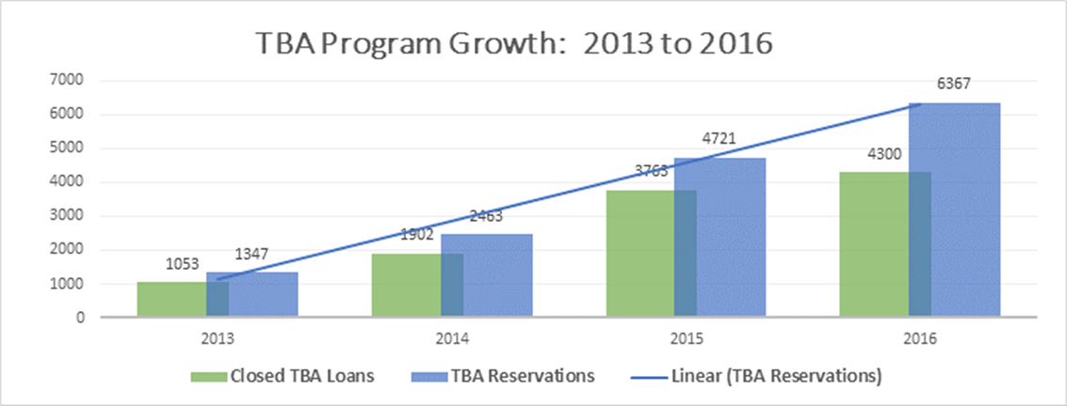

Slide 59
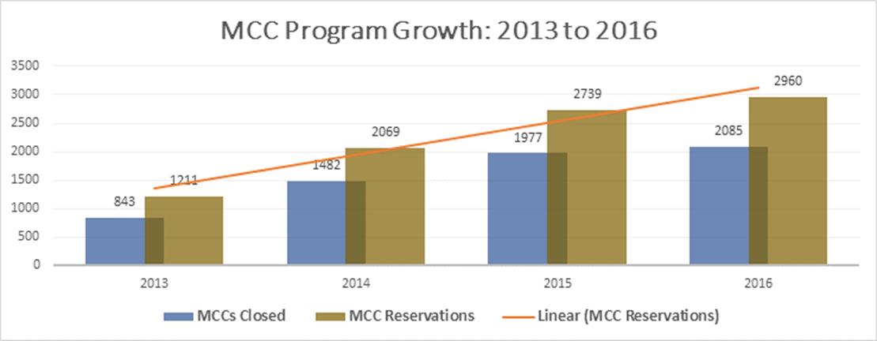

Slide 60
What funds the NCHFA’s Loan Pool programs?
HOME funds through HUD
Most frequent question: Can I get a waiver?
Our most frequent response: No.
Federal Regulations
24 CFR 92
https://www.hudexchange.info/home/

Slide 61
Future Funding
Temporary Funding INCREASE for SHLP Loans
By APRIL 17th (or possibly earlier) for New or Existing Reservations that are UNDERWRITTEN & APPROVED by August 15, 2017
Up to $45,000 per loan OR
Up to 35% of Sales Price (whichever is Greater)
HOME Funding needs to be used or returned
Loans may close later if approved by August 15th.
Updated Deed Restrictions & Buyer Written Agreement (15 years if over $40K)
Also in the news: http://wapo.st/2mDrIps?tid=ss_mail
Still very early in the budgeting process
HOME & CDBG may not be recommended for funding in the President’s budget

Slide 62
Future Funding
Temporary Funding INCREASE for CPLP
By APRIL 17th (or possibly earlier) for New or Existing Reservations that are UNDERWRITTEN & APPROVED by August 15, 2017
Up to 25% of Sales Price
HOME Funding needs to be used or returned
Loans may close later if fully approved by August 15th.
Updated Deed Restrictions & Buyer Written Agreement (15 years if over $40K)
Also in the news: http://wapo.st/2mDrIps?tid=ss_mail
Still very early in the budgeting process
HOME & CDBG may be recommended to not be funded in President’s budget

Slide 63
Questions?

Slide 64
Who to call with questions
Program Questions or When There is an Emergency
Josh Burton– 919-877-5678 or jdburton@nchfa.com
Sonia Joyner – 919-877-5630 or sbjoyner@nchfa.com
Rich Lee – 919-877-5688 or rylee@nchfa.com
Reservation and Where’s My Money Questions
Deborah Hamilton – 919-877-5709 or dmhamilton@nchfa.com
Underwriting Questions
Kim Hargrove – 919-877-5682 or kchargrove@nchfa.com
Mark Lindquist - 919-501-4263 mwlindquist@nchfa.com
Closing Documents
Liz Hair – 919-877-5712 or echair@nchfa.com
Ronda Moore – 919-875-3621 or rgmoore@nchfa.com
Payment Questions
Mary Moss - 919-877-5697 or mgmoss@nchfa.com
Potential Foreclosures and Servicing
Hal Wright- 919-877-5690 or hewright@nchfa.com

Slide 65
Thank You
We appreciate your partnership

