Slide 1
Assessment of Fair Housing (AFH)
City of Wilmington
&
Wilmington Housing Authority

Slide 2
What is an Assessment of Fair Housing (AFH)?
The AFH is required by HUD.
The AFH includes:
An analysis of fair housing data,
An assessment of fair housing issues and contributing factors, and
An identification of fair housing priorities and goals.

Slide 3
Why Conduct an AFH?
Affirmatively Furthering Fair Housing (AFFH) is a legal requirement that federal agencies and their grantees further the purposes of the Fair Housing Act.

Slide 4
Fair Housing Act
The Fair Housing Act prohibits discrimination in the sale, rental, and financing of dwellings, and in other real estate-related transactions because of race, color, religion, sex, familial status, national origin, or disability.
For the purposes of the AFFH rule, the duty to “affirmatively further fair housing” means taking meaningful actions, in addition to combating discrimination, that overcome patterns of segregation and foster inclusive communities free from barriers that restrict access to opportunity based on protected characteristics. 24 CFR § 5.152

Slide 5
Fair Housing Issues
Segregation/Integration
Racially or Ethnically Concentrated Areas of Poverty (R/ECAPS)
Disparities in Access to Opportunities
Disproportionate Housing Needs
Housing Choice

Slide 6
Segregation
Wilmington Population - 71% White & 19% Black
Black Population as % of Pop down 6% 1990-2010
Same trends in region
Hispanic Population increase 5% 1990-2010
Racial segregated residential patterns
Two Racial/Ethnically Concentrated Areas of Poverty (R/ECAPS)
R/ECAP – Northside & Southside – 6,800 pop;
R/ECAP - 77% Black; 45% families w/children
Notes:
Should follow this with a map…. For those visual folks… it quickly conveys the segregation and concentration…

Slide 7
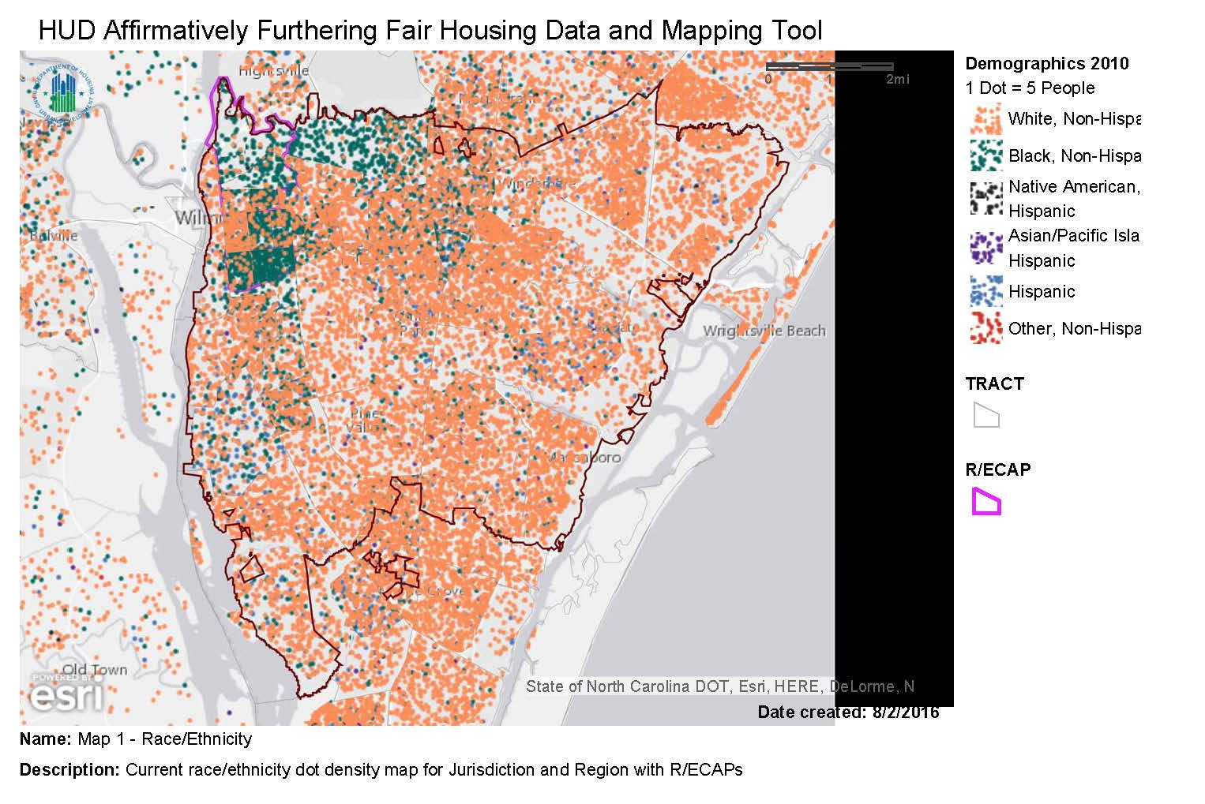

Slide 8
Racially/Ethnically Concentrated Areas of Poverty R/ECAP
Concentrated poverty has been found to have a long-term effect on outcomes for children growing up in these neighborhoods related to a variety of indicators including crime, health and education and future employment and lifetime earnings

Slide 10
Opportunity Disparity
Opportunity Disparity measured by Opportunity Index (Score)
African Americans score lower than Whites on:
Low Poverty (reside in low poverty areas)
School Proficiency
Labor Participation/Employment
Housing Need
Blacks (58%) and Hispanics (66%) experience housing problems at higher percentage than Whites (39%), including severe housing problems
Blacks (31%) experience cost burden at 10 points more than Whites (20%); and Hispanics (24%) at 4 points more than Whites

Slide 11
Low Poverty

Slide 12
School Proficiency

Slide 13
Job Proximity

Slide 14
Labor Market Engagement/ Employment

Slide 15
Transportation Cost Index

Slide 16
Fair Housing Issues
Publicly Supported Housing
Disability and Access
Fair Housing Enforcement
Outreach Capacity
Resources

Slide 17
Public Housing
Table 5 - Publicly Supported Housing Units by Program Category
 | (Wilmington, NC CDBG, HOME) Jurisdiction
Housing Units | # | %
Total housing units | 54,462 | -
Public Housing | 1,028 | 1.89
Project-based Section 8 | 1,034 | 1.90
Other Multifamily | 165 | 0.30
HCV Program | 1,616 | 2.97
Note 1: Data Sources: Decennial Census; APSH
Note 2: Refer to the Data Documentation for details (www.hudexchange.info).

Slide 18
Public Housing
Table 6 - Publicly Supported Housing Residents by Race/Ethnicity
 | Race/Ethnicity
(Wilmington, NC CDBG, HOME) Jurisdiction | White |  | Black |  | Hispanic |  | Asian or Pacific Islander
Housing Type | # | % | # | % | # | % | # | %
Public Housing | 53 | 6.06 | 806 | 92.22 | 11 | 1.26 | 1 | 0.11
Project-Based Section 8 | 515 | 53.87 | 355 | 37.13 | 49 | 5.13 | 33 | 3.45
Other Multifamily | 120 | 76.92 | 32 | 20.51 | 0 | 0.00 | 3 | 1.92
HCV Program | 241 | 18.34 | 1,028 | 78.23 | 41 | 3.12 | 2 | 0.15
0-30% of AMI | 4,465 | 56.16 | 2,739 | 34.45 | 405 | 5.09 | 25 | 0.31
0-50% of AMI | 7,350 | 54.06 | 4,199 | 30.89 | 880 | 6.47 | 60 | 0.44
0-80% of AMI | 13,120 | 59.99 | 6,069 | 27.75 | 1,360 | 6.22 | 100 | 0.46
(Wilmington, NC CDBG, HOME) Jurisdiction | 77,998 | 71.26 | 21,056 | 19.24 | 6,592 | 6.02 | 1,355 | 1.24
Note 1: Data Sources: Decennial Census; APSH; CHAS
Note 2: #s presented are numbers of households not individuals.
Note 3: Refer to the Data Documentation for details (www.hudexchange.info).

Slide 19
Disability by Type
Table 13 - Disability by Type
 | (Wilmington, NC CDBG, HOME) Jurisdiction |  | (Wilmington, NC CBSA) Region
Disability Type | # | % | # | %
Hearing difficulty | 3,681 | 3.59 | 9,749 | 4.04
Vision difficulty | 2,601 | 2.53 | 5,634 | 2.34
Cognitive difficulty | 5,292 | 5.16 | 11,888 | 4.93
Ambulatory difficulty | 7,696 | 7.50 | 18,899 | 7.83
Self-care difficulty | 2,587 | 2.52 | 6,283 | 2.60
Independent living difficulty | 4,814 | 4.69 | 11,399 | 4.73
Note 1: All % represent a share of the total population within the jurisdiction or region.
Note 2: Data Sources: ACS
Note 3: Refer to the Data Documentation for details (www.hudexchange.info).

Slide 20
Severe Housing Cost Burden
Table 10 - Demographics of Households with Severe Housing Cost Burden
Households with Severe Housing Cost Burden* | (Wilmington, NC CDBG, HOME) Jurisdiction |  |  | (Wilmington, NC CBSA) Region
Race/Ethnicity | # with severe cost burden | # households | % with severe cost burden | # with severe cost burden | # households | % with severe cost burden
White, Non-Hispanic | 6,875 | 34,835 | 19.74 | 13,160 | 84,430 | 15.59
Black, Non-Hispanic | 2,620 | 8,364 | 31.32 | 3,870 | 14,709 | 26.31
Hispanic | 450 | 1,855 | 24.26 | 760 | 3,783 | 20.09
Asian or Pacific Islander, Non-Hispanic | 90 | 355 | 25.35 | 115 | 850 | 13.53
Native American, Non-Hispanic | 40 | 100 | 40.00 | 40 | 290 | 13.79
Other, Non-Hispanic | 245 | 725 | 33.79 | 395 | 1,365 | 28.94
Total | 10,320 | 46,225 | 22.33 | 18,340 | 105,405 | 17.40
Household Type and Size
Family households, <5 people | 3,480 | 22,370 | 15.56 | 7,230 | 58,960 | 12.26
Family households, 5+ people | 375 | 1,675 | 22.39 | 855 | 5,480 | 15.60
Non-family households | 6,485 | 22,190 | 29.22 | 10,250 | 40,960 | 25.02
Note 1: Severe housing cost burden is defined as greater than 50% of income.
Note 2: All % represent a share of the total population within the jurisdiction or region, except household type and size, which is out of total households.
Note 3: The # households is the denominator for the % with problems, and may differ from the # households for the table on severe housing problems.
Note 4: Data Sources: CHAS
Note 5: Refer to the Data Documentation for details (www.hudexchange.info).

Slide 21
Housing Cost Burden

Slide 22
Choice
Fair housing choice involves individuals and families having the information, opportunity, and options to live where they choose without unlawful discrimination and other barriers related to race, color, religion, sex familial status, national origin, or disability, and that their choices realistically include housing options in integrated area and areas with access to opportunity

Slide 23
Fair Housing Goals
Goals must be measureable, tracked, and directly related to overcoming the significant contributing factors identified
The goals will be incorporated into subsequent planning processes and documents
HUD advises a “Balanced Approach”
Notes:
HUD has advised a balanced approach….

Slide 24
Fair Housing Goals (cont.)
Goal 1: Increase Affordable Housing Options
Goal 2: Maintain Existing Affordable Housing
Goal 3: Increase Local Housing Enforcement Efforts
Goal 4: Reduce Housing Discrimination Based on Disabilities
Goal 5: Expand & Improve Access to Funding Sources for Affordable Housing Development
Notes:
Give examples throughout this part of the presentation

Slide 25
Fair Housing Goals (cont.)
Goal 6: Increase Homeownership Opportunities
Goal 7: Improve Educational Supportive Services
Goal 8: Improve Access to Employment Training Opportunities
Goal 9: Improve Access to Employment Opportunities
Goal 10: Improve Access to Public Transportation
Notes:
Give examples, recall the issue with occupancy code no more than 3 unrelated persons per residence….
Erich to provide examples during presentation – mixed use planning/development, accessory dwelling units, minimum lot and building sizes, set back requirements, etc. etc. Density bonuses, impact and permit fee waivers etc.

Slide 26
Fair Housing Goals (cont.)
Goal 11: Improve Public Perception of Affordable Housing
Goal 12: Improve Land Use & Planning Efforts

Slide 27
HUD Submission
Draft AFH Public Comment September 2nd
Public Hearing September 20th
AFH Submission October 4th
HUD Review & Approval
Inconsistent with Fair Housing or Civil Rights Requirements
Substantially Incomplete

Slide 28
Next Steps
Implementation in Consolidated Plan and Annual Action Plans
Collaborative Effort amongst City departments & w/ stake holders

